Slide 1

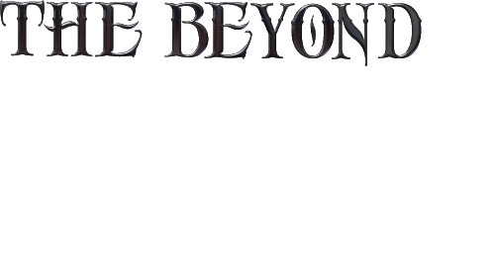
An immersive Adventure, RPG.
Team Members Addee
Georgia Ash

Slide 2
THE BEYOND
IS A THIRD PERSON, SINGLE PLAYER
WORLD, FILLED WITH MYTHICAL CREATURES,
BOUND TO LOST STORIES AND HISTORY.
DISCOVER WHAT IS ODD ABOUT THIS WORLD.
ADVENTURE THROUGH BEAUTIFUL AND DANGEROUS LANDS.
IMMERSE AND EXPERIENCE
YOUR WAY!
YOUR PATH!
YOUR ADVENTURE!

Slide 3
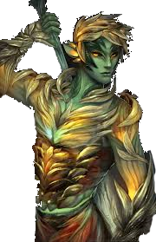
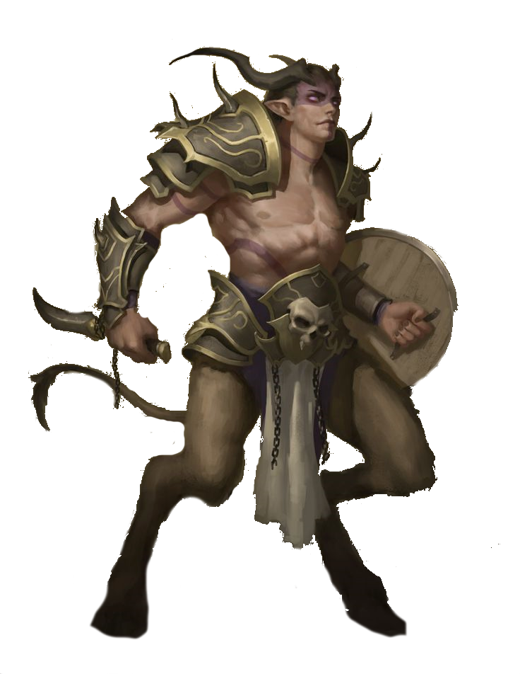
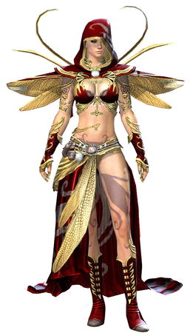
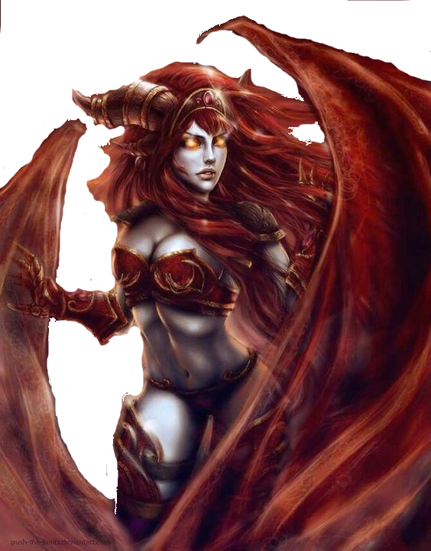
Target Audience
General:
People interested in role playing
The Beyond offers players the ability to roleplay, whether as themselves or a character, through race selection, chosen dialogue, NPC interactions, and the skills they learn.
People interested in Greek mythology, medieval and fantasy themes
The Beyond will feature these themes through lore, design and various mechanics.
Niche:
People interested in old-school, stat based RPGs
The Beyond features a stat system similar to older RPGs and MMORPGs such as Rift, Diablo, Dragon Age: Origins, and EverQuest. Many of these games still retain dedicated fanbases, yet fans have few options in terms of similar stat mechanics in modern games.

Slide 4
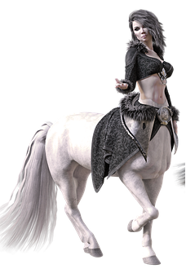
Platform
The Beyond is an open world adventure, puzzle and open world RPG.
The game play is based on foundational elements of current and past RPG single player games. The player is immersed in a mythical world with connections to earth, surrounded by Greek themed environment.
Setting and Aesthetic
High Fantasy, Greek inspired
Detailed characters and environments
Music:TBD
UI: Medieval fantasy
Target Platform:
PC (main)
PlayStation/XBox (stretch goal)

Slide 5
Story Prologue
Long ago, the Ancient Guardians of Time combined their powers to create a sentient being who, in turn, created life on Earth and mythological beings. As time went by, an unknown Ancient Guardian created humans amongst the creatures to rule the mythological beings. Peace and cohabitation diminished, chaos and destruction rained upon the world.
Something had to be done.
The Ancients returned and discovered that humans were corrupting and driving the other species to extinction. So, they split their world in two, leaving humans to rule one and mythical creatures to rule the other, Banishing the humans to another dimension. But with this the Ancient Guardians unknowingly ripped the fabric of time. Portals have begun appearing on Earth leading historical artefacts and humans to the other world. In this land humans can only live for a short time. To survive, they have to make a choice;
Morph into one of these fantastical creatures, or die.

Slide 6
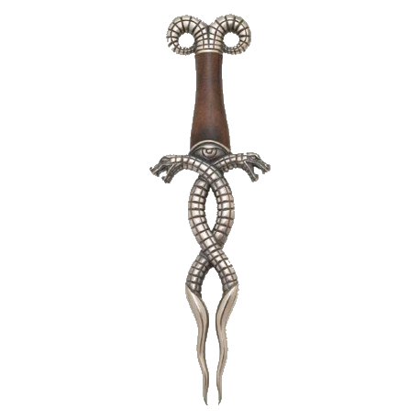
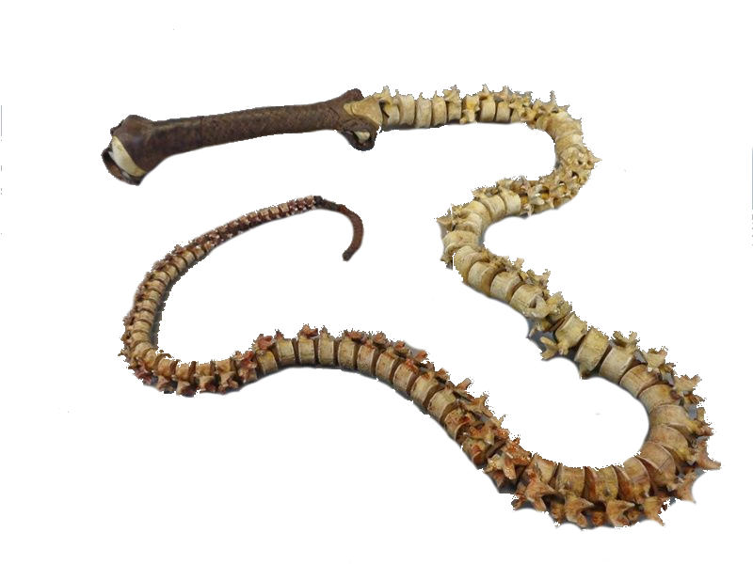
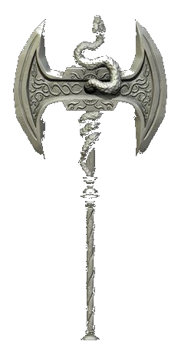
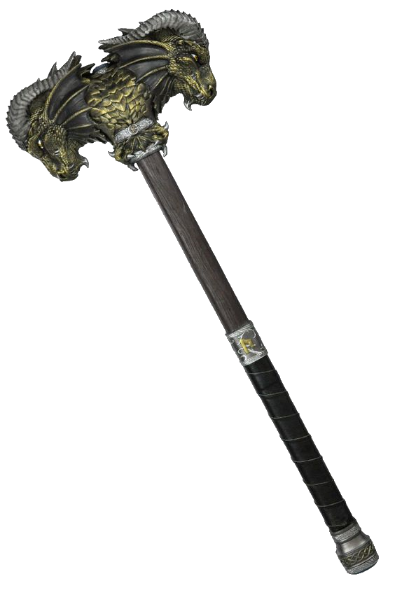
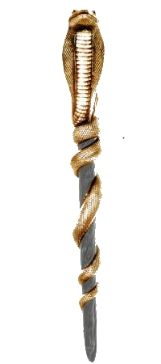
The Vision
Fast paced action, with multiple opportunities for battle. A variety of weapon options for your character: One-Handed, Two-Handed, Ranged and Melee.

Slide 7
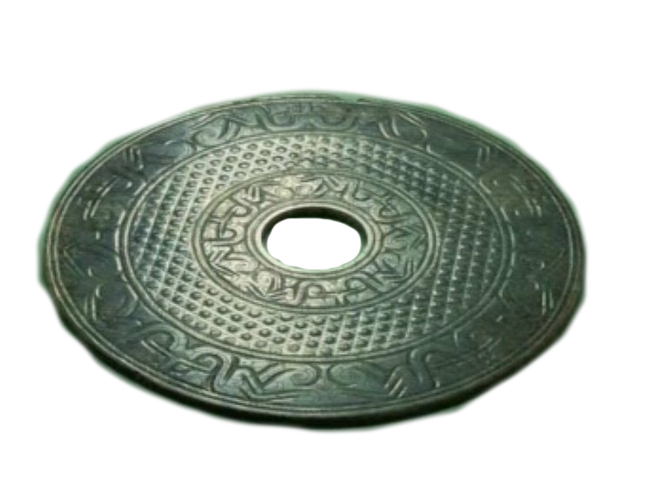
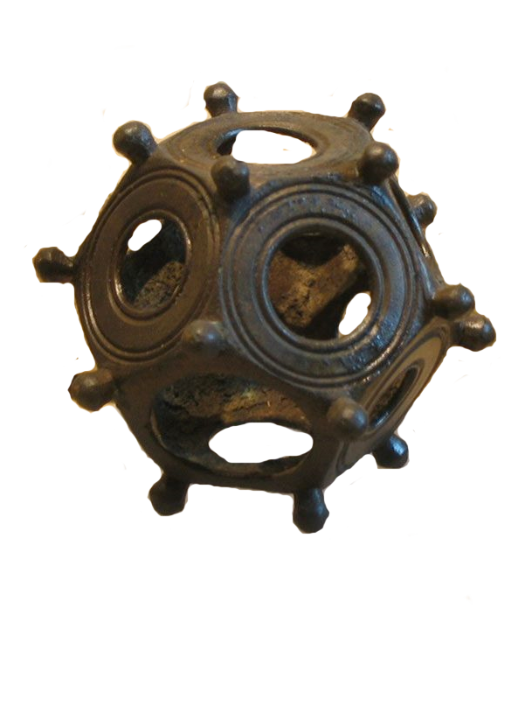
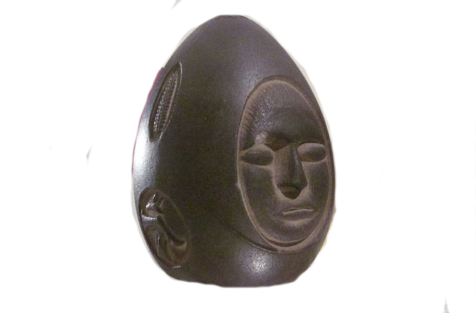
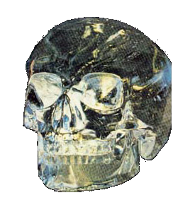
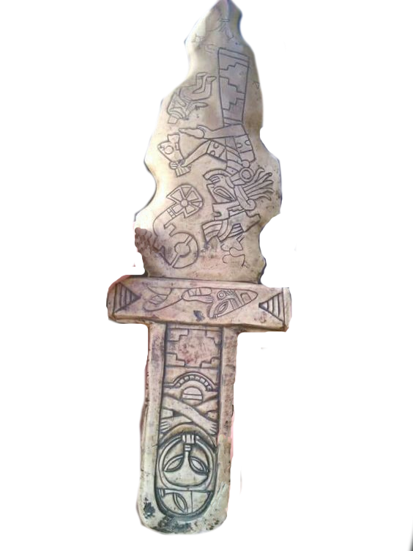
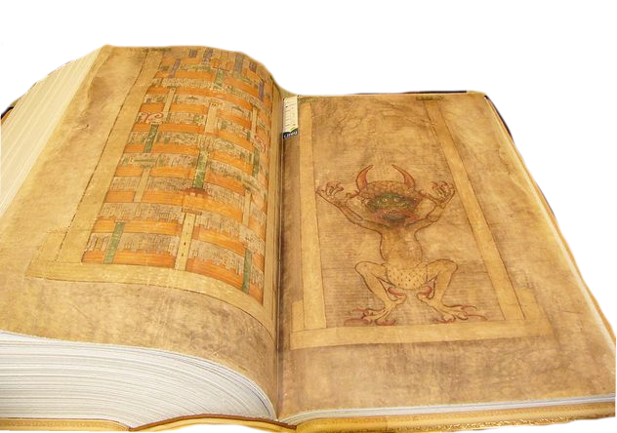
Ancient Earth artefacts keep appearing and locals are frightened, unaware of what they are...

Slide 8
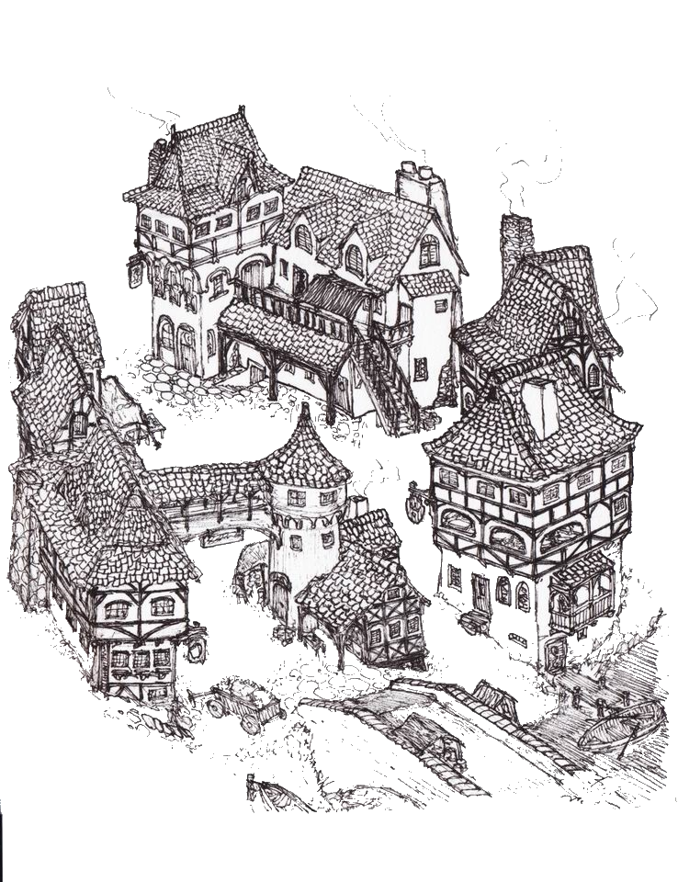
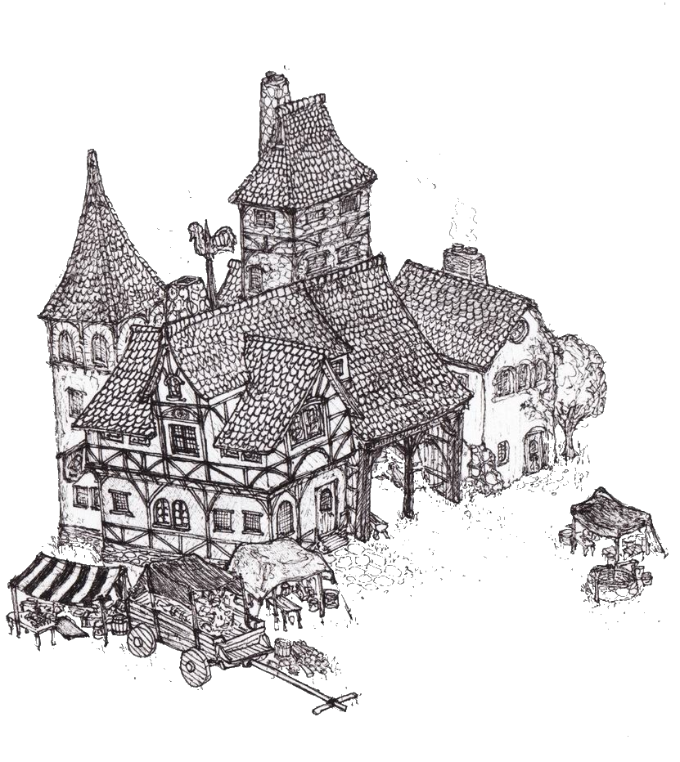
The town that you arrive in...

Slide 9
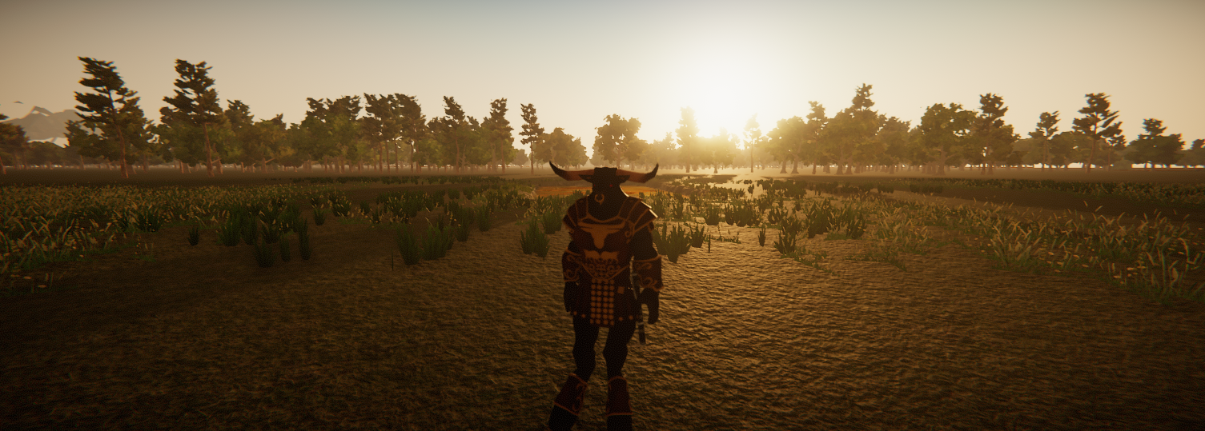
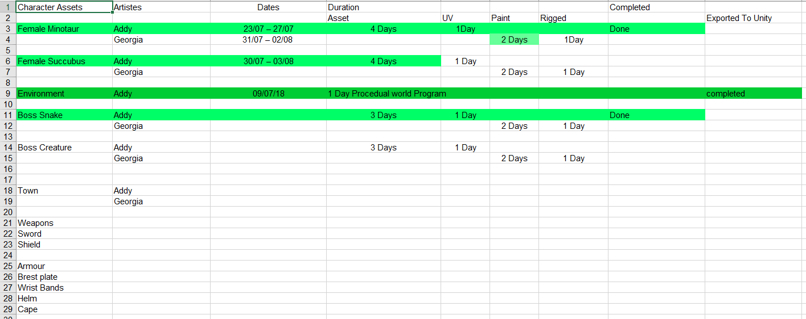
Art Timeline

Slide 10
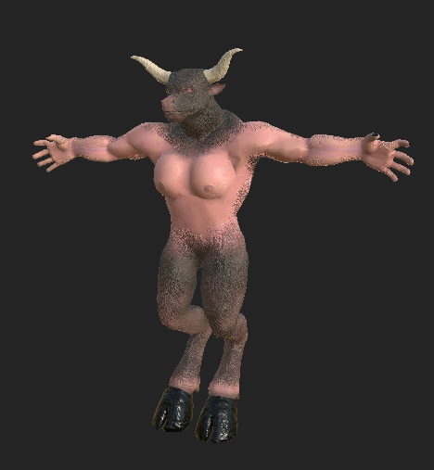
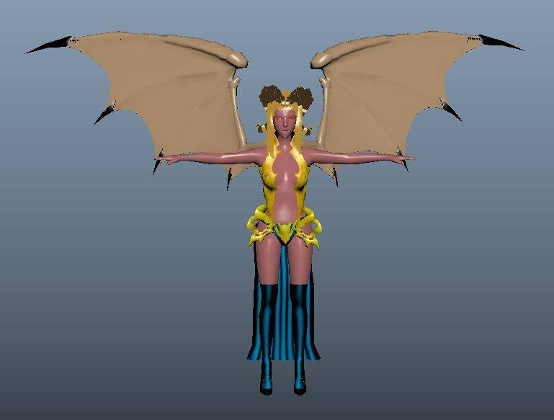
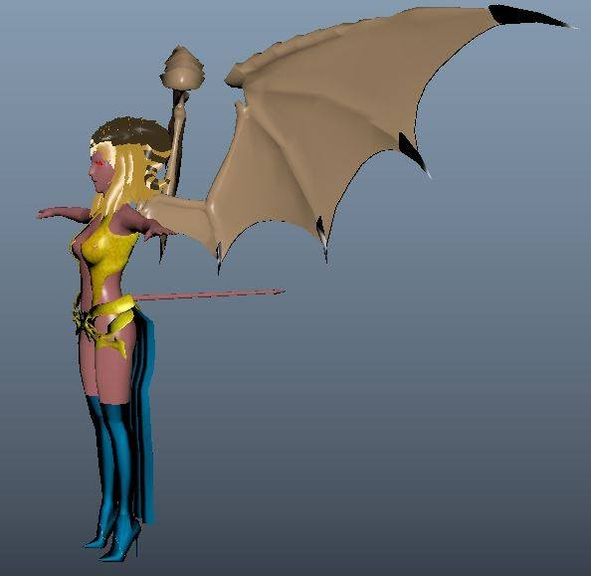
Minotaur and Succubus models in progress

Slide 11
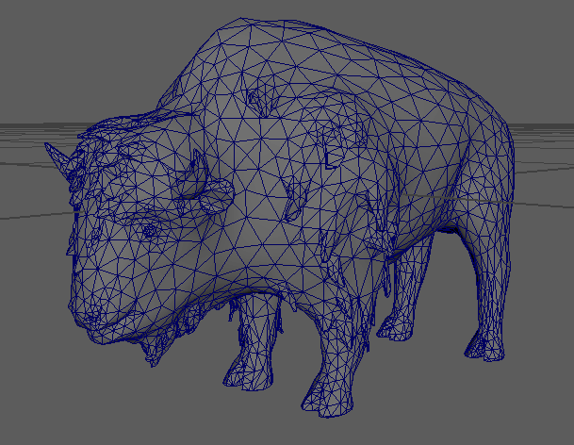
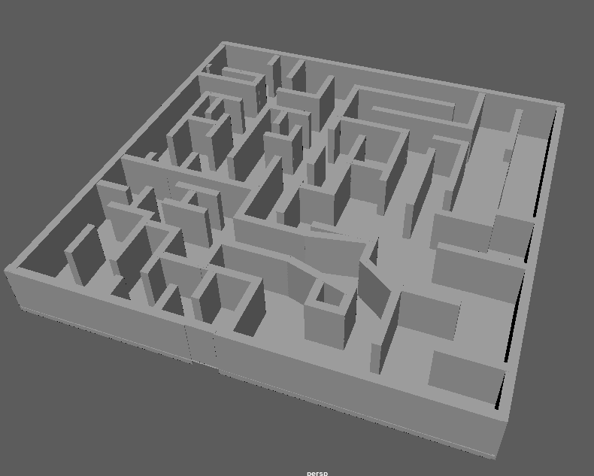
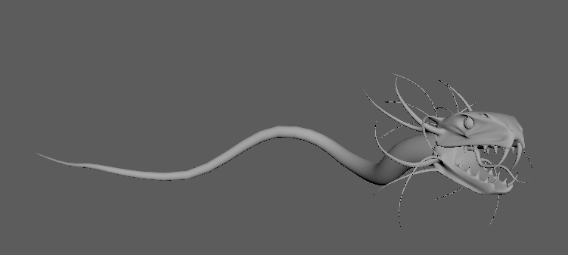
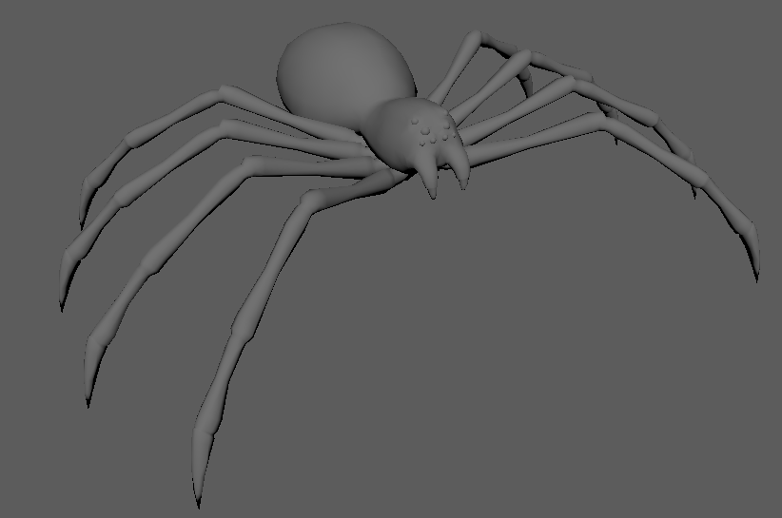

Slide 12
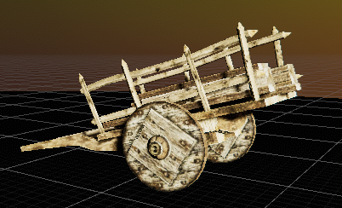
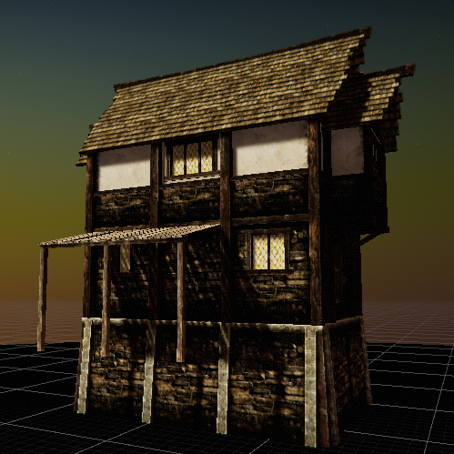
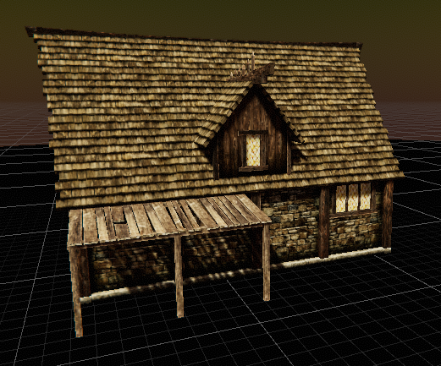
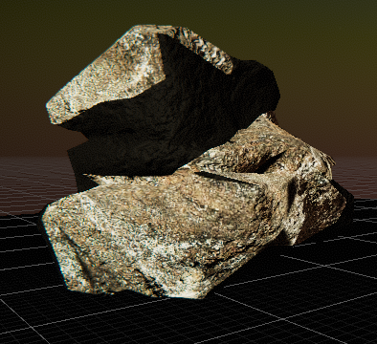
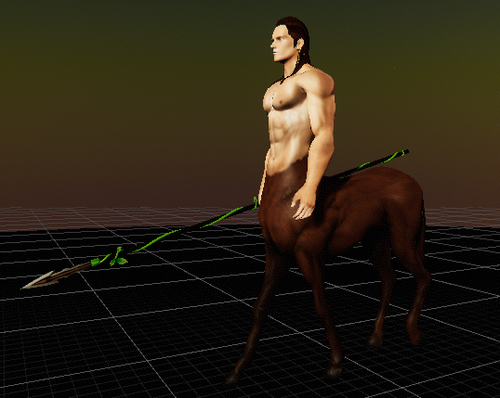
Some of our downloaded assets planned for use

Slide 13
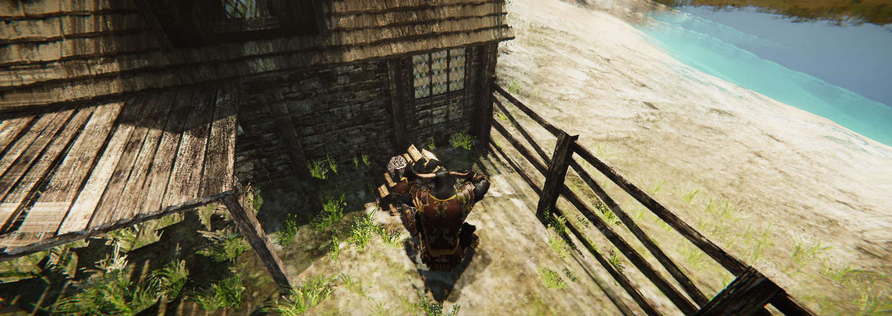
Gameplay
Old-school RPG gameplay
Stats such as Strength, Dexterity, Intelligence, Wisdom, Charisma, Constitution, Evade
Battle enemies with the skills you learn
Obtain and sell loot from battle
Complete quests for NPCs

Slide 14
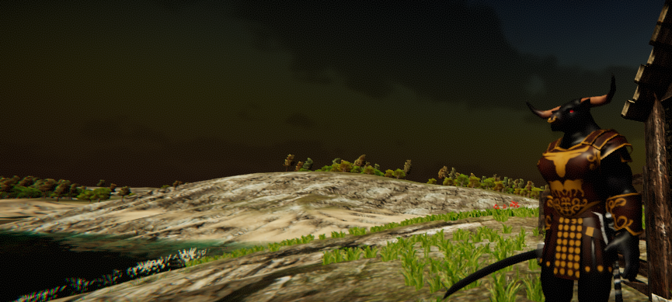
DEMO
GAME PLAY
Single player Game play, at least an hour worth of content including quests
Main Quest (Story)
Fetch Quests
Two Races to choose from at minimum viable product
Minotaur
Succubus
Three basic enemies, one big bad boss
Cursed Anaconda
Wolf
Bandit
"The Gorgon was made out of the terror, not the terror out of the Gorgon."

Slide 15
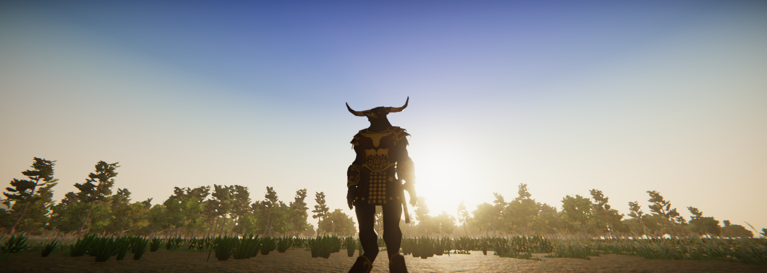
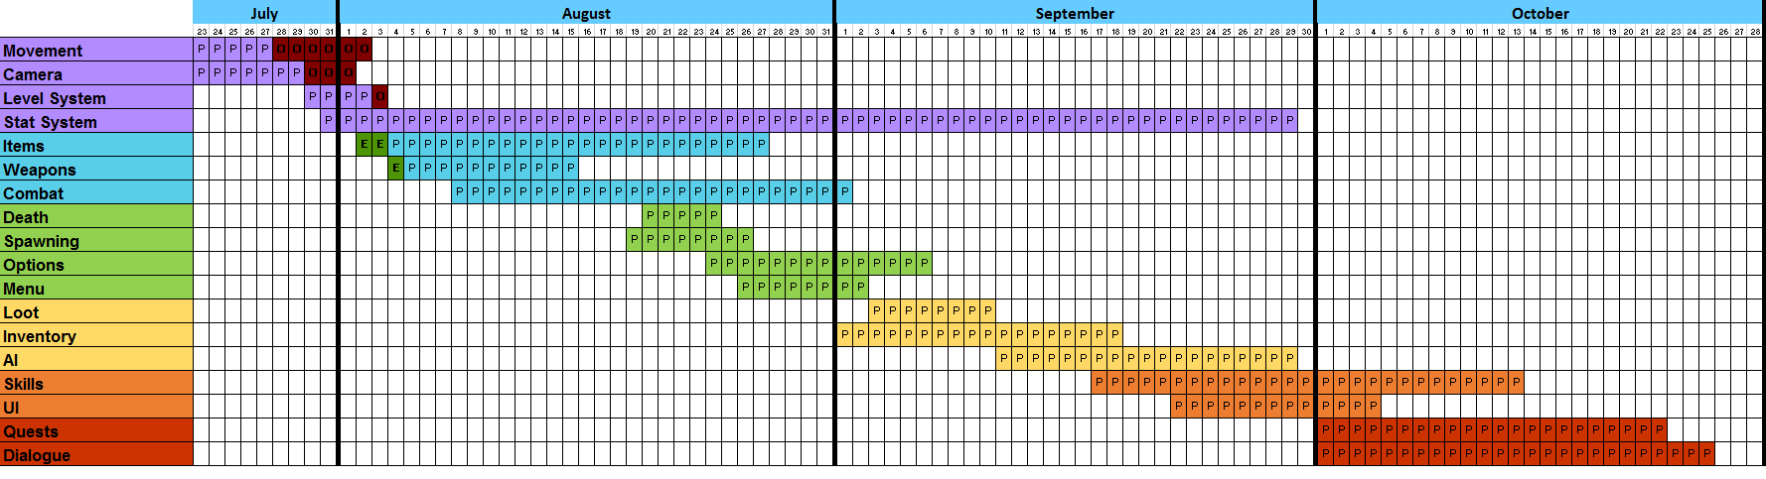
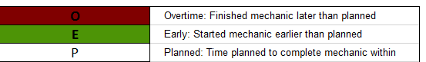
Programming Timeline

